Slide 1
Singular Value Decomposition in Text Mining

Slide 2
Class Outline
Summary of last lecture
Indexing
Vector Space Models
Matrix Decompositions
Latent Semantic Analysis
Mechanics
Example

Slide 3
Summary of previous class
Principal Component Analysis
Singular Value Decomposition
Uses
Mechanics
Example swap rates

Slide 4
Introduction
How can we retrieve information using a search engine?.
  We can represent the query and the documents as vectors (vector space model)
    However to construct these vectors we should perform a preliminary document preparation.
  The documents are retrieved by finding the closest distance between the query and the document vector.
    Which is the most suitable distance to retrieve documents?

Slide 5
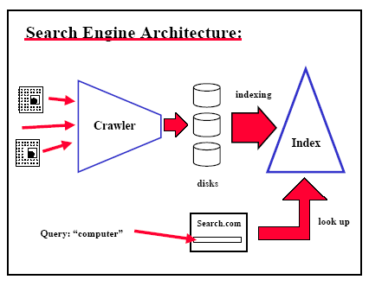
Search engine

Slide 6
Document File Preparation
Manual Indexing
  Relationships and concepts between topics can be established
  It is expensive and time consuming
  It may not be reproduced if it is destroyed.
  The huge amount of information suggest a more automated system

Slide 7
Document File Preparation
Automatic indexing
To buid an automatic index, we need to perform two steps:
  Document Analysis
    Decide what information or parts of the document should be indexed
  Token analysis
    Decide with words should be used in order to obtain the best representation of the semantic content of documents.

Slide 8
Document Normalization
After this preliminary analysis we need to perform another preprocessing of the data
  Remove stop words
    Function words: a, an, as, for, in, of, the…
    Other frequent words
  Stemming
    Group morphological variants
      Plurals “ streets” -> “street”
      Adverbs “fully” -> “full”
    The current algorithms can make some mistakes
      “police“, “policy” -> “polic”

Slide 9
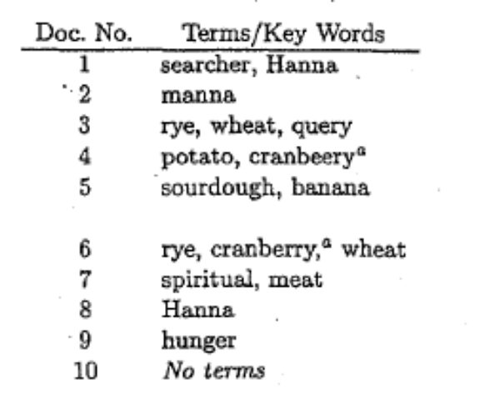
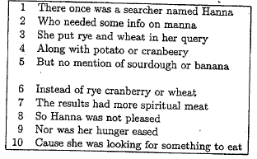
File Structures
Once we have eliminated the stop words and apply the stemmer to the document we can construct:
Document File
  We can extract the terms that should be used in the index and assign a number to each document.

Slide 10
File Structures
Dictionary
  We will construct a searchable dictionary of terms by arranging them alphabetically and indicating the frequency of each term in the collection
Term | Global Frequency
banana | 1
cranb | 2
Hanna | 2
hunger | 1
manna | 1
meat | 1
potato | 1
query | 1
rye | 2
sourdough | 1
spiritual | 1
wheat | 2

Slide 11
File Structures
Inverted List
  For each term we find the documents and its related position associated with
Term | (Doc, Position)
banana | (5,7)
cranb | (4,5); (6,4)
Hanna | (1,7); (8,2)
hunger | (9,4)
manna | (2,6)
meat | (7,6)
potato | (4,3)
query | (3,8)
rye | (3,3);(6,3)
sourdough | (5,5)
spiritual | (7,5)
wheat | (3,5);(6,6)

Slide 12
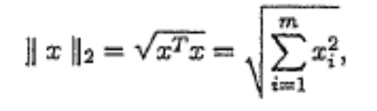
Vector Space Model
  The vector space model can be used to represent terms and documents in a text collection
  The document collection of n documents can be represented with a matrix of m X n where the rows represent the terms and the columns the documents
  Once we construct the matrix, we can normalize it in order to have unitary vectors

Slide 13
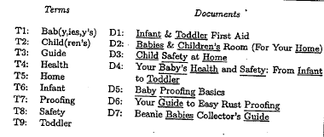
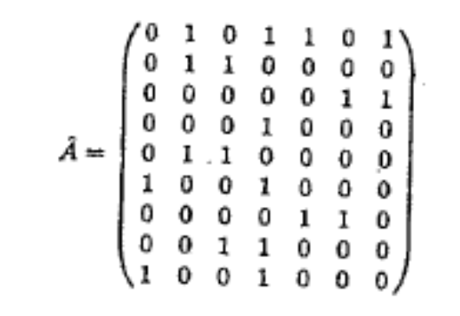
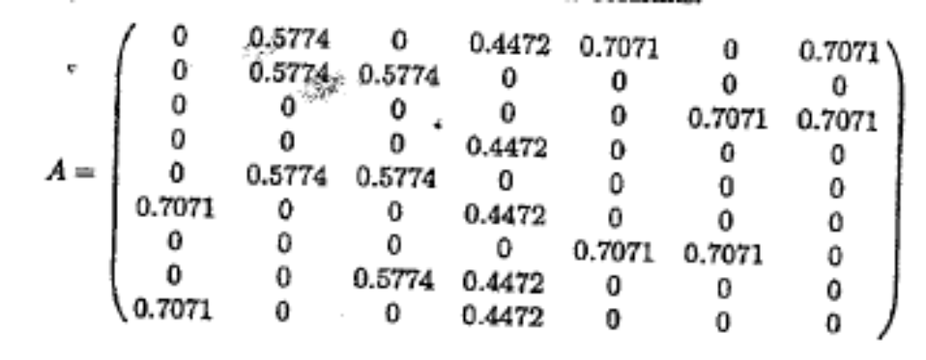
Vector Space Models

Slide 14
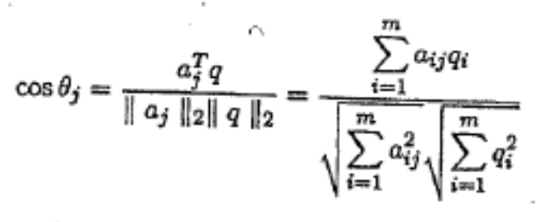
Query Matching
If we want to retrieve a document we should:
  Transform the query to a vector
  look for the most similar document vector to the query. One of the most common similarity methods is the cosine distance between vectors defined as:
  Where a is the document and q is the query vector

Slide 15
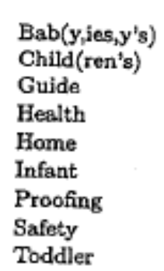
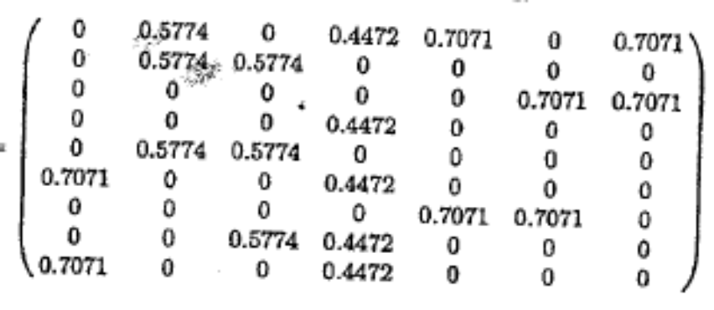
Example:
Using the book titles we want to retrieve books of “Child Proofing”
Book titles
Query
0
1
0
0
0
1
0
0
Cos θ₂=Cos θ₃=0.4082
Cos θ₅=Cos θ₆=0.500
With a threshold of 0.5, the 5th and the 6th would be retrieved.

Slide 16
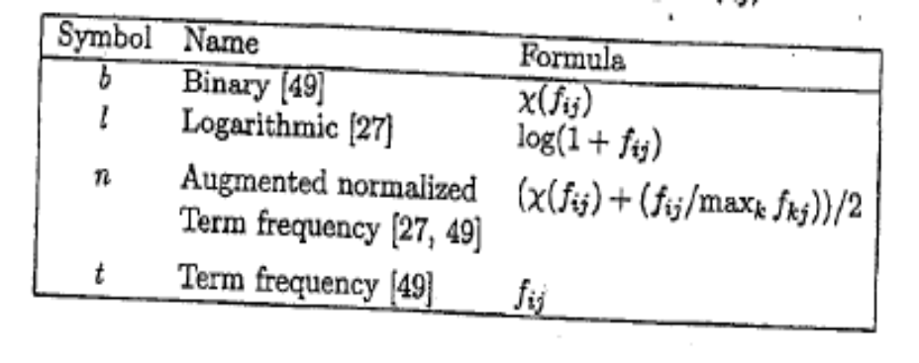
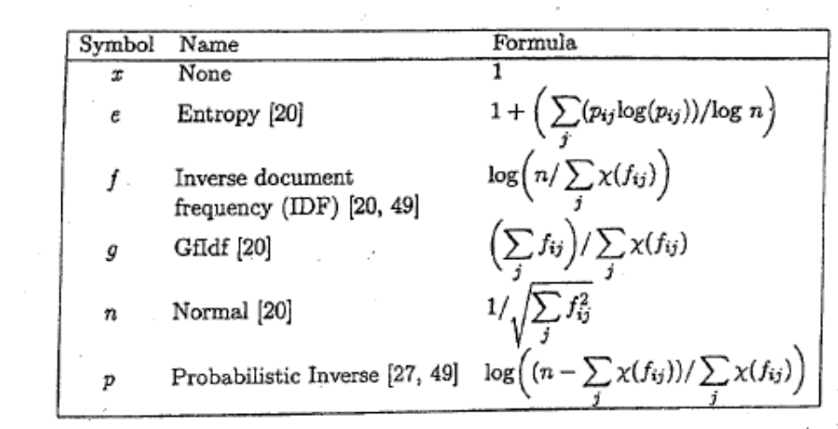
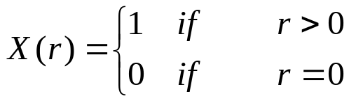
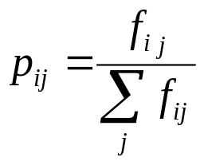
Term weighting
In order to improve the retrieval, we can give to some terms more weight than others.
Local Term Weights
Global Term Weights
Where

Slide 17
Synonymy and Polysemy
auto
engine
bonnet
tyres
lorry
boot
car
emissions
hood
make
model
trunk
make
hidden
Markov
model
emissions
normalize
Synonymy
Will have small cosine
but are related
Polysemy
Will have large cosine
but not truly related

Slide 18
Matrix Decomposition
To produce a reduced –rank approximation of the document matrix, first we need to be able to identify the dependence between columns (documents) and rows (terms)
  QR Factorization
  SVD Decomposition

Slide 19
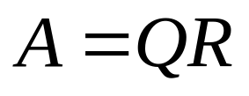
QR Factorization
The document matrix A can be decomposed as below:
  Where Q is an mXm orthogonal matrix and R is an
  mX m upper triangular matrix
This factorization can be used to determine the basis vectors for any matrix A
This factorization can be used to describe the semantic content of the corresponding text collection

Slide 20
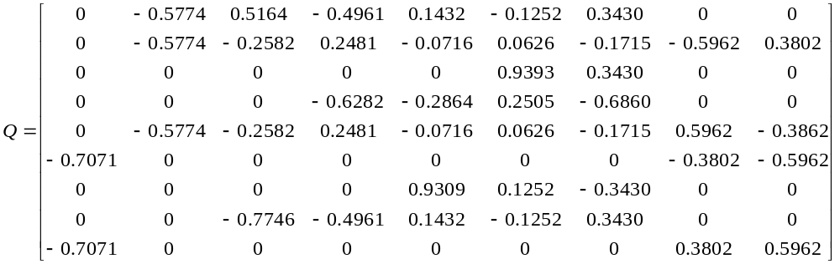
Example
A=

Slide 21
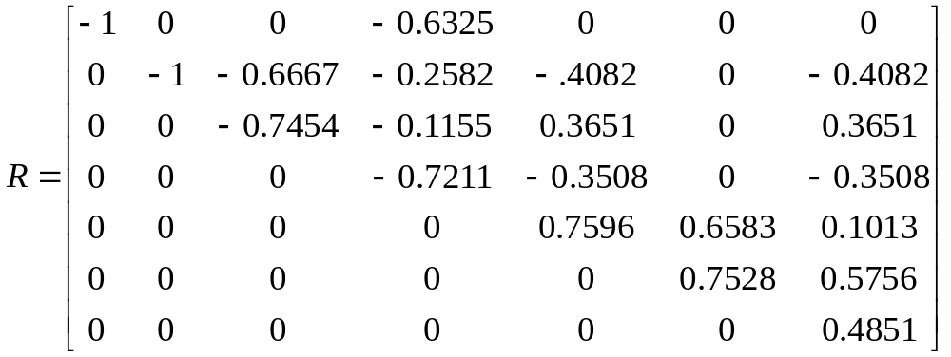
Example

Slide 22
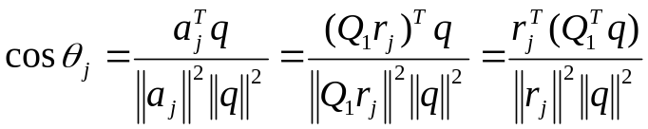
Query Matching
We can rewrite the cosine distance using this decomposition
Where r_{j} refers to column j of the matrix R

Slide 23
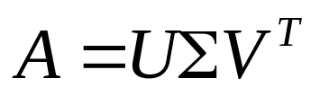
Singular Value Decomposition (SVD)
This decomposition provides a reduced rank approximations in the column and row space of the document matrix
This decomposition is defined as
m×m
m×n
V is n×n
Where the columns U are orthogonal eigenvectors of AA^{T}.
The columns of V are orthogonal eigenvectors of A^{T}A.
Eigenvalues λ1 … λr of AA^{T} are the square root of the eigenvalues of A^{T}A.

Slide 24
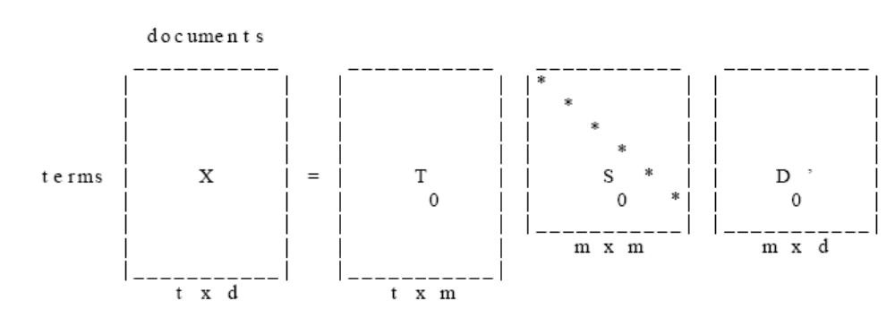
Latent Semantic Decomposition (LSA)
It is the application of SVD in text mining.
  We decompose the document-term matrix A into three matrices
A
V
U
The V matrix refers to terms
and U matrix refers to documents

Slide 25
Latent Semantic Analysis
Once we have decomposed the document matrix A we can reduce its rank
  We can account for synonymy and polysemy in the retrieval of documents
  Select the vectors associated with the higher value of Σ in each matrix and reconstruct the matrix A

Slide 26
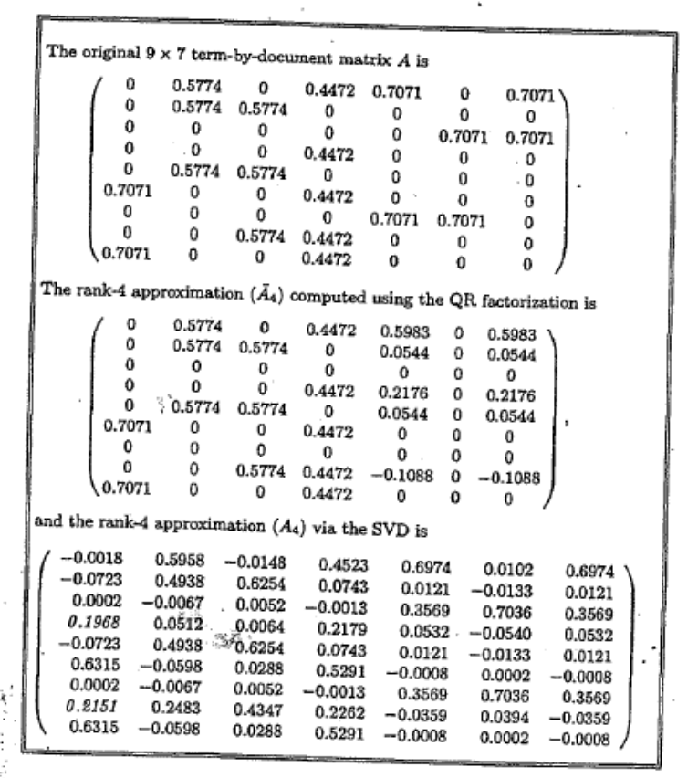
Latent Semantic Analysis

Slide 27
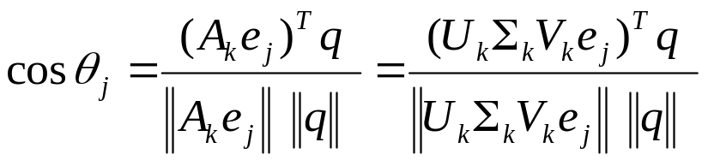
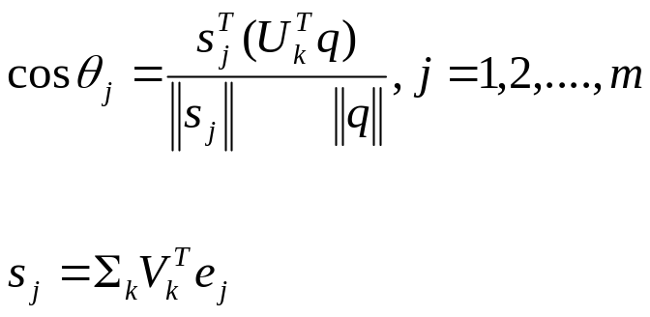
Query Matching
The cosines between the vector q and the n document vectors can be represented as:
where e_{j} is the canonical vector of dimension n
This formula can be simplified as
where

Slide 28
Example
Apply the LSA method to the following technical memo titles
c1: Human machine interface for ABC computer applications
c2: A survey of user opinion of computer system response time
c3: The EPS user interface management system
c4: System and human system engineering testing of EPS
c5: Relation of user perceived response time to error measurement
m1: The generation of random, binary, ordered trees
m2: The intersection graph of paths in trees
m3: Graph minors IV: Widths of trees and well-quasi-ordering
m4: Graph minors: A survey

Slide 29
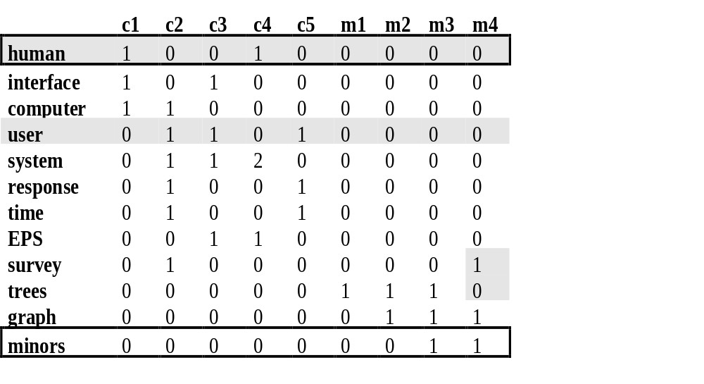
Example
First we construct the document matrix

Slide 30
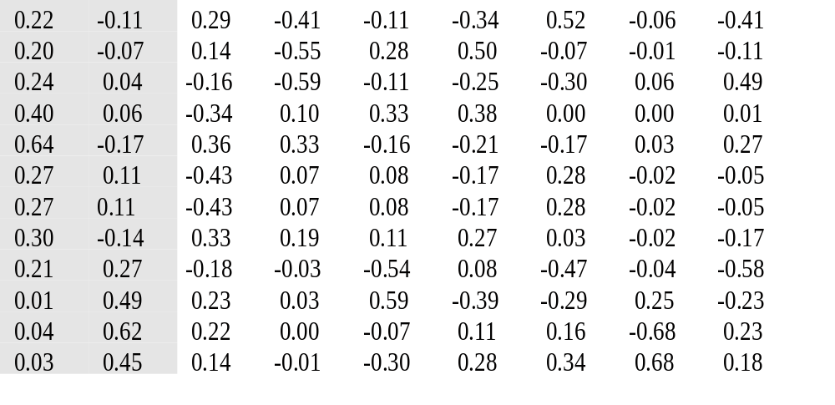
Example
The Resulting decomposition is the following
{U} =

Slide 31
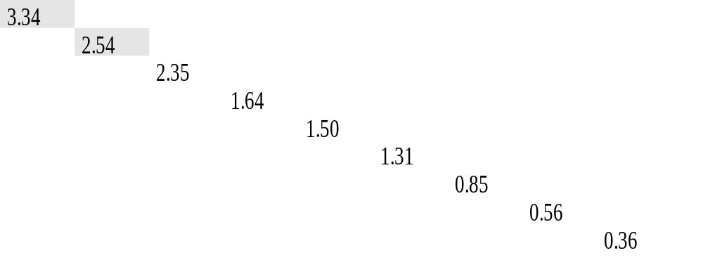
Example
{} =

Slide 32
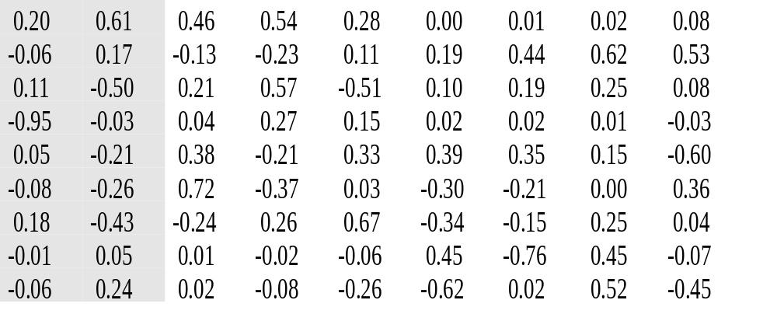
Example
{V} =

Slide 33
Example
We will perform a 2 rank reconstruction:
  We select the first two vectors in each matrix and set the rest of the matrix to zero
  We reconstruct the document matrix

Slide 34
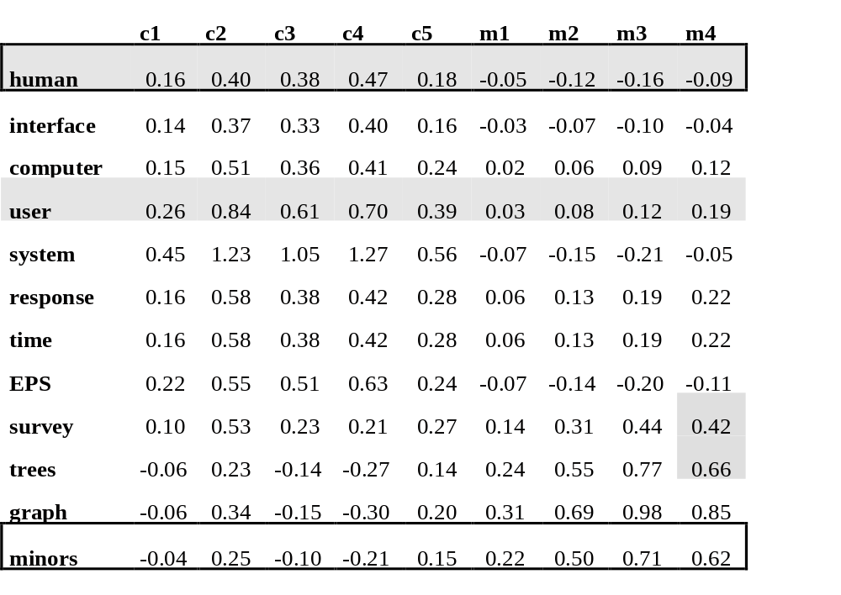
Example
The word user seems to have presence in the documents where the word human appears

